Slide 1

Parkinson Disease Detection
by
B. Venkata Prasad Reddy
Roll No. 194G5A0511
V. Thripura
Roll No. 184G1A05A5
K. Shirisha
Roll No. 184G1A0586
M. Sahitha
Roll No. 184G1A0570
Under the guidance of
Mr. M. Narasimhulu _{M.Tech(PhD)}
Assistant Professor
Department of Computer Science and Engineering
Srinivasa Ramanujan Institute of Technology
(Affiliated to JNTUA & Approved by AICTE) (Accredited by NAAC with ‘A’ Grade & Accredited by NBA (EEE, ECE & CSE)
Rotarypuram Village, B K Samudram Mandal, Ananthapuramu – 515701.
2021 - 2022

Slide 2

Contents
Introduction
Existing System
Proposed System
Literature Survey
Problem Definition
Planning
Requirements to develop or implement a project
DataFlow Diagram
Architecture
Implementation
Result
Conclusion
References(What you have studied for project-journals,Conference papers,Books,Links)

Slide 3
Abstract
Parkinson disease is a neurodegenerative disorder. It affects on dopamine producing neurons in brain. This disease mostly affect on the organic functions of the human body. It affects the age group above 45 , in which out of 31 persons 5 are detected . Rigid muscles ,Speech , Amnesia , depression are most likely Symptoms of this disease. The above symptoms will also match with other disorders. Based on the symptoms ,it is unpredictable to diagnose the disease.
Most Machine Learning algorithms are implemented to detect the Parkinson disease. We plan to implement Parkinson Disease Detection using Machine Learning Algorithms like SVM , Random Forest Algorithm , XGBoost , KNN Algorithm. To Analyze Parkinson Disease Accuracy by varying the trained dataset and test dataset.

Slide 4
Introduction
To identify whether a person is having Parkinson’s disease or not, we downloaded the dataset from www.kaggle.com
There are 24 columns in the dataset,each column the symptoms values of a patient except the status column. The status column has 0’s and 1’s ;those values will decide the affected person with Parkinson’s disease. one indicates person effected ,zero indicates person unaffected.

Slide 5
Existing System
In existing system, Parkinson Disease is detected at the secondary stage only (Dopamine deficiency) which leads to medical challenges. Also doctor has to manually examine and suggest medical diagnosis in which the symptoms might vary from person to person so suggesting medicine is also a challenge. Thus the mental disorders are been poorly characterized and have many health complications. Parkinson Disease is generally diagnosed with the following clinical methods as,
• MRI or CT scan - Conventional MRI cannot detect early signs of Parkinson's disease
• PET scan(Positron Emission Tomography) - is used to assess activity and function of brain regions involved in movement

Slide 6
SPECT scan(Single Photon Emission Computerized Tomography) - can reveal changes in brain chemistry, such as a decrease in dopamine.This results in a high misdiagnosis rate (up to 25% by non-specialists) and many years before diagnosis, people can have the disease. Thus existing system is not effective in early prediction and accurate medical diagnosis to the affected people

Slide 7
Proposed System
In this model, the huge amount of data is collected from previously affected person.
These data is trained by using machine learning algorithms.
From the whole data , 60% used for training and 40% to be for testing.
We are going to apply the four algorithms and compare the results with one another ,and after that by using some mathematical theorems we predict whether the person is affected by parkinson disease or not.

Slide 8
Literature Survey
[1] Saloni,R.K. Sharma proposed a system by SVM algorithm.SVMs are set of related supervised learning methods used for classification and regression.SVM simultaneously minimize the empirical classification error and maximize the geometric margin. In all cases, a maximum margin hyperplane is selected which have the largest separation between the two classes.Maximum margin hyper plane is a plane from which distance to the nearest data point on both sides is maximized.
[2] Gayatri J Proposed a Voice Analysis For Detecting Parkinson’s Disease.In This the KNN algorithm is used for data classification based on similarity.This method can be applied to the data from any distribution,Even Samples is large it can be classified perfectly.The overall accuracy is 94.3%.But by using the neural network and feature collection ,the accuracy is 80.69% so we are going to implement KNN algorithm.

Slide 9
[3] Mirza Muntasir proposed a system by XG Boost Algorithm.XG Boost is a gradient boosting framework-based ensemble machine learning algorithm [33]. This algorithm appears to be one of the most effective algorithms for performing regression,classification,ranking and predictive analysis.It is capable of completing a wide range of tasks by using gradient descent layout to improve weak features in datasets.
[4] Koray Acici,Cagatay Berke Erdas proposed a system by Random Forest. Random Forest is an extended version of bagging algorithm with randomness property injected [25].Random Forest splits every node to branches using the best onefrom randomly selected variables on every node instead of using the best branch through all variables.Random Forest uses CART(Classification and Regression Tree) algorithm to produce trees.

Slide 10
Problem Definition
Early detection of Parkinson’s disease (PD) is particularly relevant, as people at early stages of the disease are more likely to benefit from neuroprotective treatments.
The problem definition of Parkinson disease detection is previously detected by voice that is very difficult to find the disease.
And also it is taking more time to give result.

Slide 11
Requirements
Hardware Requirements
Intel® Core(TM) i3
Minimum 4GB of RAM
Software Requirements
Python 3
Pycharm
Some other libraries:numpy,pandas,matplotlib.

Slide 12
Dataflow Diagram
Parkinson
Dataset
80% data store
Data Preprocessing
Split
Model Training
Model Testing
Accuracy
Output
20% data store

Slide 13
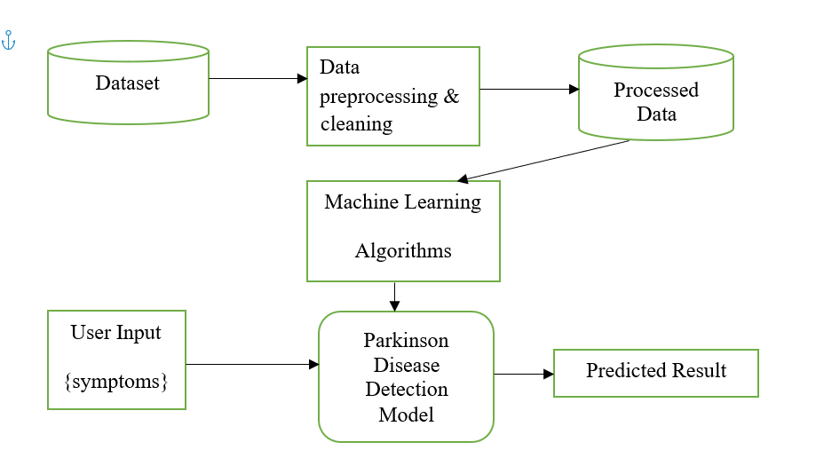
Architecture

Slide 14
Implementation:
Read the input data:
data = pd.read_csv(‘parkinsons.csv’)
BarGraph:
x,y=df['status'].value_counts()
xpoints=np.array(['Parkinson Affected Person','Parkinson not Affected Person'])
ypoints=np.array([x,y])
mlt.bar(xpoints,ypoints)
mlt.show()
Splitting the data set into training and testing set with 20% test data split
X_train,X_test,Y_train,Y_split = train_test_split(X,Y,test_size=0.2,random state=7)

Slide 15
Code
Initialize the algorithms
Initialize the XGBclassifier:
model2 = XGBClassifier()
model2.fit(x_train,y_train)
#predict the output for x_test
y_pred2=model2.predict(x_test)
Accuracy2 = accuracy_score(y_test, y_pred2)
#calculate accuracy,root mean squared error
print("Accuracy of XGBClassifier :",accuracy_score(y_test, y_pred2))
print('Mean Absolute Error:', mean_absolute_error(y_test, y_pred2))
print('Root Mean Squared Error:', np.sqrt(mean_squared_error(y_test, y_pred2)))

Slide 16
Code
Initialize the SVM:
model1 = svm.SVC(kernel = 'linear')
model1.fit(x_train,y_train)
#predict the output for x_test
y_pred1=model1.predict(x_test)
Accuracy1 = accuracy_score(y_test, y_pred1)
#calculate accuracy,root mean squared error
print("Accuracy of SVM :",accuracy_score(y_test, y_pred1))
print('Mean Absolute Error:', mean_absolute_error(y_test, y_pred1))
print('Root Mean Squared Error:', np.sqrt(mean_squared_error(y_test, y_pred1)))

Slide 17
Code
Initialize the random forest:
model= RandomForestClassifier(random_state=2)
model.fit(x_train,y_train)
#predict the output for x_test
y_pred=model.predict(x_test)
Accuracy = accuracy_score(y_test, y_pred)
#calculate accuracy,root mean squared error
print("Accuracy of RandomForest :",accuracy_score(y_test, y_pred))
print('Mean Absolute Error:', mean_absolute_error(y_test, y_pred))
print('Root Mean Squared Error:', np.sqrt(mean_squared_error(y_test, y_pred)))

Slide 18
Code
Initialize the knn:
model3 = KNeighborsClassifier(n_neighbors=3)
model3.fit(x_train,y_train)
#predict the output for x_test
y_pred3=model3.predict(x_test)
Accuracy3 = accuracy_score(y_test, y_pred3)
#calculate accuracy,root mean squared error
print("Accuracy of KNeighborsClassifier :",accuracy_score(y_test, y_pred3))
print('Mean Absolute Error:', mean_absolute_error(y_test, y_pred3))
print('Root Mean Squared Error:', np.sqrt(mean_squared_error(y_test, y_pred3)))
Sample Snippiet:
if(prediction[0]>=50):
print(“The person does not have parkinsons Disease”)
else:
print(“The person has parkinsons”)

Slide 19
Project Planning
Week | Work
Week1 | Downloading and installing software’s
Week2 | Data including and presentation on dataset
Week3 | Develop on project
Week4 | Training our model
Week5 | Testing the model

Slide 20
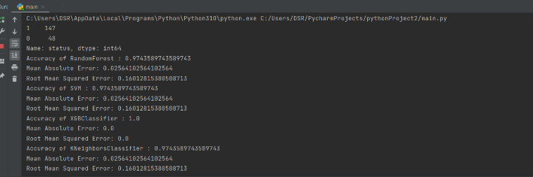
Result
Input
Accuracy

Slide 21
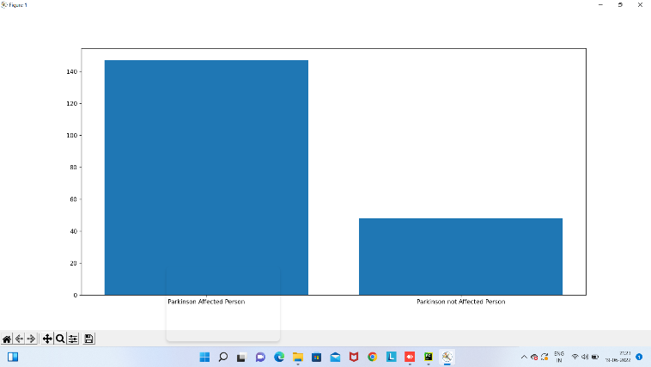
Condt…
Result Graph
Finally it is detecting the Parkinson Disease (Whether a person is having Parkinson disease or not)

Slide 22
Conclusion
we proposed that this project Parkinson Disease Detection using machine learning is very much useful in everyone's day to day life.
It is mainly more important for the healthcare sector, because they are the one that daily uses these systems to detect the Parkinson disease of the patients based on their general information and their symptoms that they are been through.
In case he/she doesn't want to go to the hospital or any other clinics, so just by entering the symptoms or information the user can get to know whether he/she having Parkinson disease or not, the health industry can also get benefit from this system by just asking the symptoms from the user and entering in the system and in just few seconds they can tell the exact and up to some extent the accurate values.

Slide 23
Condt…
If health industry adopts this project, then the work of the doctors can be reduced.
Detect for the disease that when unchecked and sometimes ignored can turns into fatal disease and cause lot of problem to the patient and as well as their family members.

Slide 24
References
[1]. D. Heisters, “Parkinson’s: symptoms, treatments and research,”
British Journal of Nursing where the paper published, vol. 20, no. 9, pp. 548–554, 2011.
[2].”Parkinson Disease Detection” , Kaggle.com
Available in : https://www.kaggle.com/nidaguler/park...
[3] L., Naranjo, C.J., Pérez, J., Martín, Y., Campos-Roca, "A two-stage variable selection and classification approach for Parkinson’s disease detection by using voice recording replications", COMPUT METH PROG BIO, vol. 142, pp.147-156, 2017.
[4] H., Lee, L.,Guan, I., Lee,"Video analysis of human gait and posture to determine neurological disorders", EURASIP J. Image Video PROC., vol. 1, pp. 380867, 2008.

Slide 25
Thank You!!!

